Slide 1
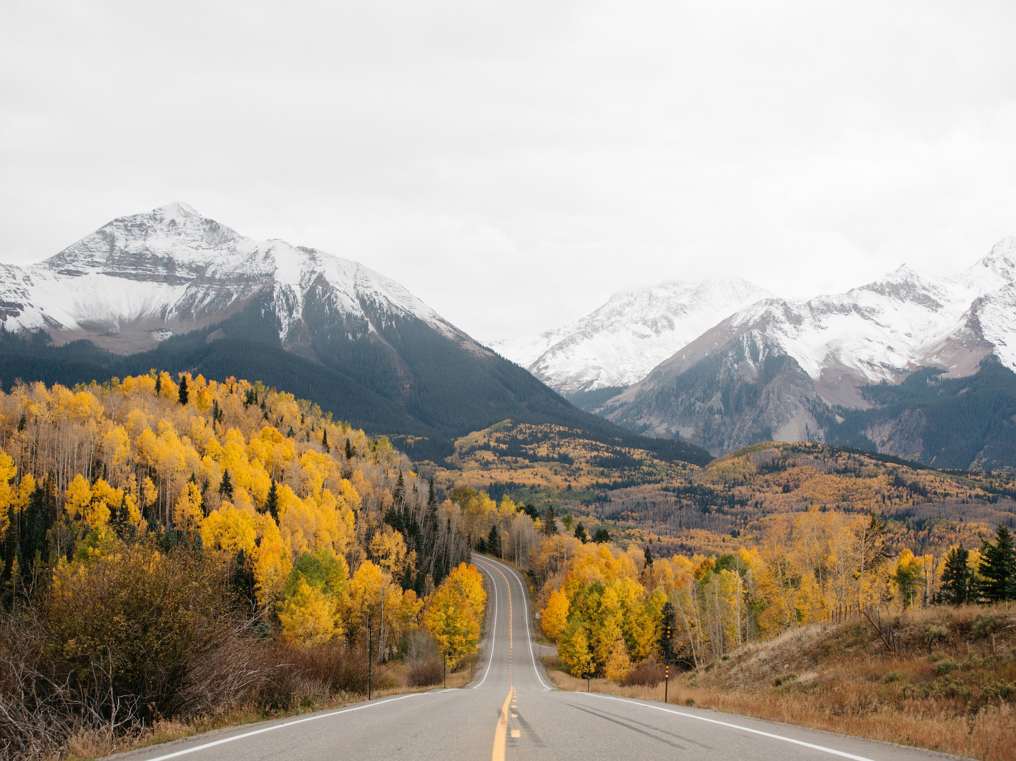
Stress-induced mutagenesis: Evolutionary perspective
Yoav Ram
Stanford University
Soon: IDC Herzliya
10 May 2018

Slide 2



Variability in mutation rates
Between species
Rates are in average number of measurable mutations per genome per generation
Flies: 0.455
Keightley et al. Gen Res 2009
Humans: 41
Lynch, PNAS 2010
Bacteria: 0.0004
Wielgoss et al. G3 2011

Slide 3
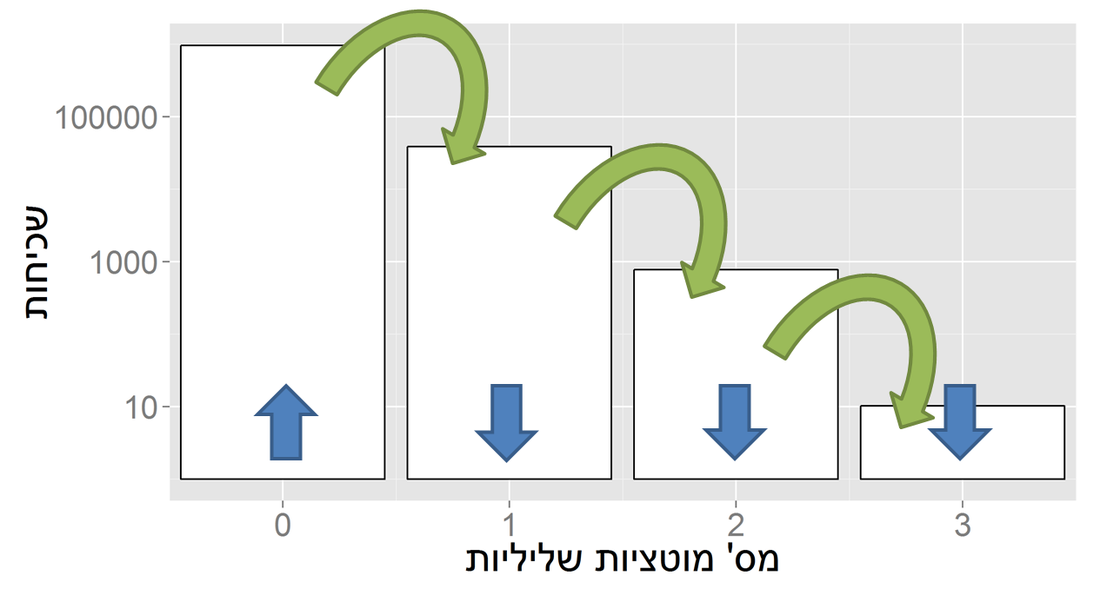
Evolution in constant environments
Directional selection without change
A balance between mutation and natural selection
Frequency
# Deleterious mutations

Slide 4
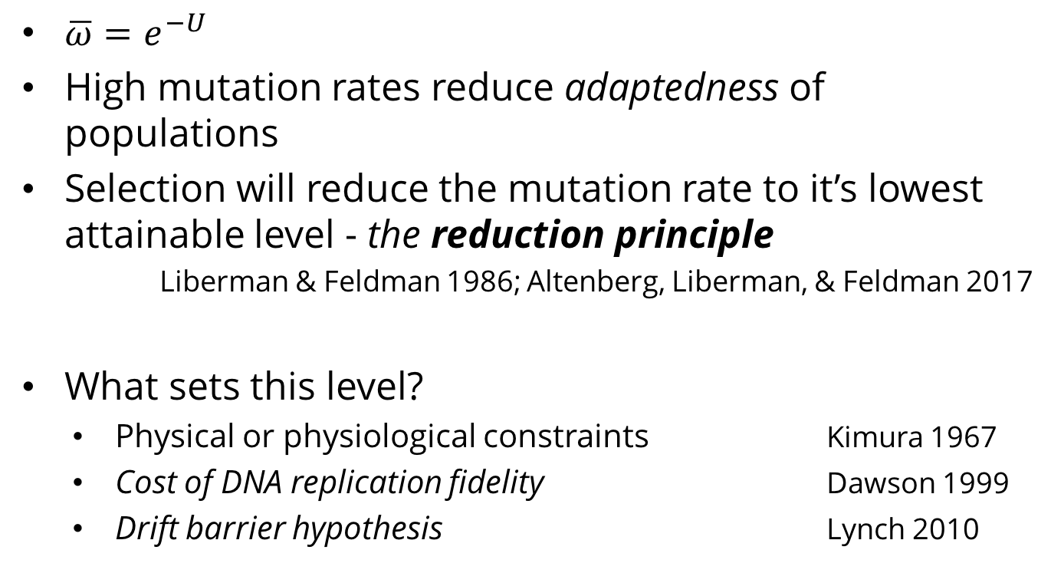
Mutation rate in constant environments
$\overline{ω}=e^{−U}$
High mutation rates reduce adaptedness of populations
Selection will reduce the mutation rate to it’s lowest attainable level - the reduction principle
Liberman & Feldman 1986; Altenberg, Liberman, & Feldman 2017
What sets this level?
Physical or physiological constraints Kimura 1967
Cost of DNA replication fidelity Dawson 1999
Drift barrier hypothesis Lynch 2010

Slide 5
Real-time mutations
Robert et al., Science 2018

Slide 6
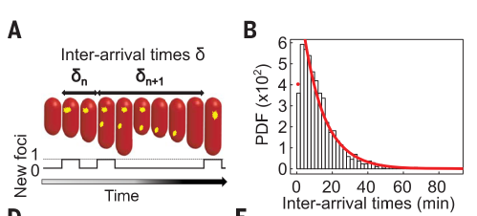
Real-time mutations
Robert et al., Science 2018

Slide 7
Changing environments

Slide 8
Changing environments
In changing environments rapid adaptation can be favored by natural selection (adaptability)
The mutation rate must balance between adaptability and adaptedness
Leigh 1973

Slide 9

Variability in mutation rates
Within species
Mutation rate in 69 natural populations of E. coli
Matic et al. 1997

Slide 10
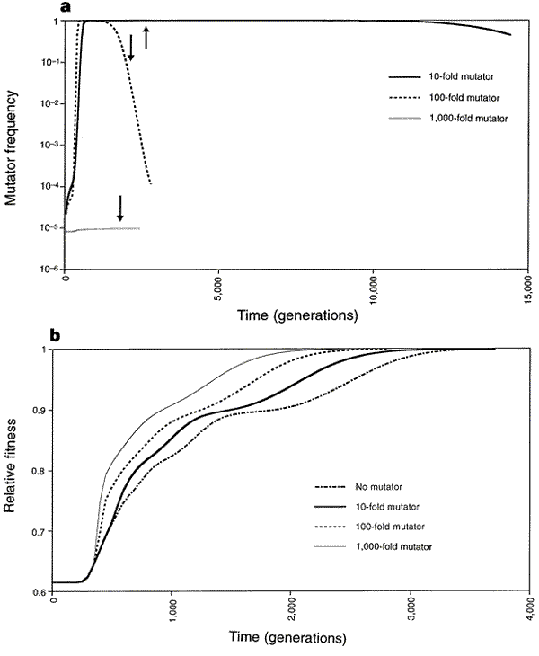
Adaptation with mutator alleles
x100
x10
x1
x1,000
Taddei et al. Nature 1997

Slide 11
Rise and fall of the mutator allele
x10
x100
x1,000
Taddei et al. Nature 1997
Notes:
An arrow symbolizes the time when population fitness has reached 0.99

Slide 12
Rise and fall: LTEE
LTEE: Long term evolutionary experiment
Richard Lenski
E. coli
Daily transfer
Started Feb 1988
>10,000 transfer
> 66,000 generations

Slide 13
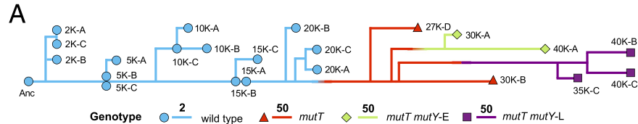
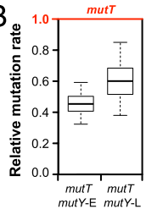
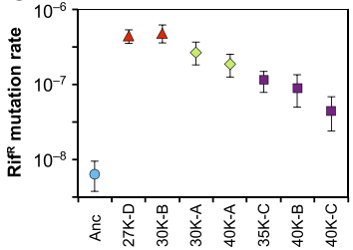
Rise and fall: LTEE
E. coli, LTEE: Wielgoss et al., PNAS 2012

Slide 14
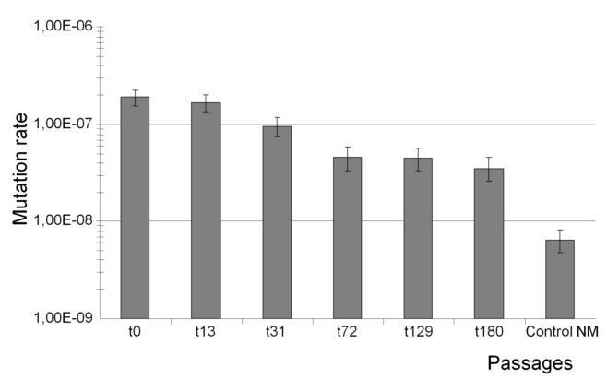
Fall of the mutator allele
E. coli, MutS: Turrientes et al. PLOS One 2013

Slide 15

Variability in mutation rates
Within individuals
DNA polymerase error rate Lynch 2011

Slide 16

Stress-induced mutation
Rosenberg et al. 2012
In E. coli:
Error prone polymerase induced by stress responses:
SOS response
DNA damage
Starvation
Mismatch repair system
Other mechanisms:
Galhardo et al. 2007
Al Mamun, Science 2012

Slide 17

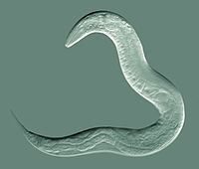
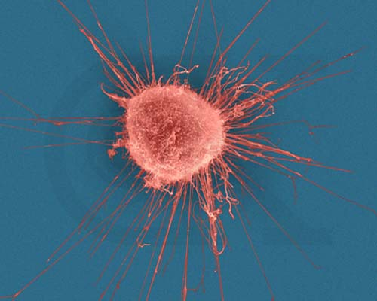



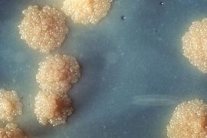

Evidence
Green algea
Nematodes
E. coli
Bacillus subtilis
Breast cancer cell
D. Melanogaster
M. tuberculosis
L. monocytogenes

Slide 18

Evolution of stress-induced mutation
Null hypothesis
Mutagenesis is the by-product of stress
Alternative non-adaptive hypotheses
Cost of replication fidelity
Drift barrier hypothesis
Adaptive hypothesis
2nd order selection

Slide 19
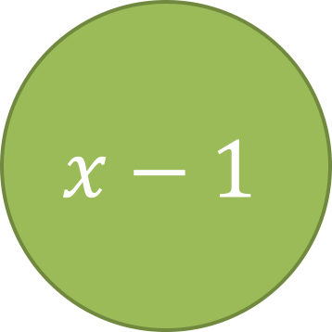
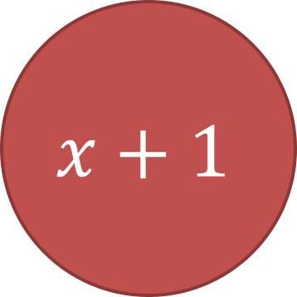
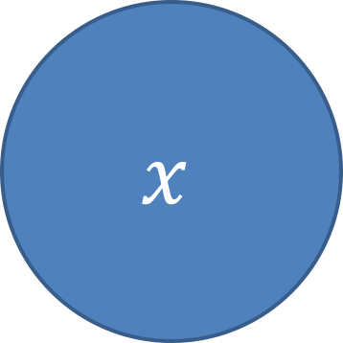
Constant environment
x – number of mutant genes
beneficial mutations
$$x−1$$
$$x$$
$$x+1$$
deleterious mutations
Ram & Hadany, Evolution 2012

Slide 20


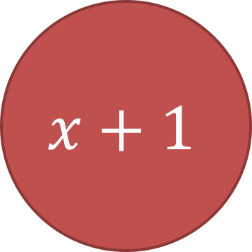
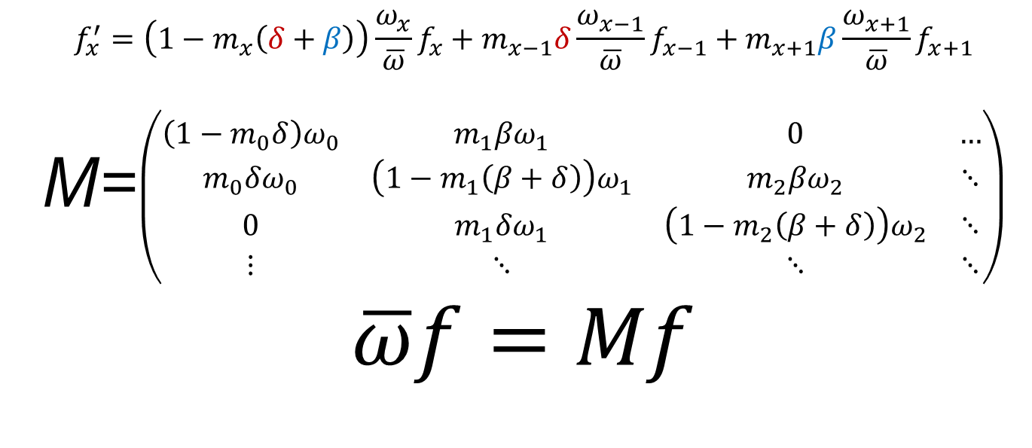
$$x−1$$
$$x$$
$$x+1$$
$$f_{x}^{′}=\left(1−m_{x}\left(δ+β\right)\right)\frac{ω_{x}}{\overline{ω}}f_{x}+m_{x−1}δ\frac{ω_{x−1}}{\overline{ω}}f_{x−1}+m_{x+1}β\frac{ω_{x+1}}{\overline{ω}}f_{x+1}$$
M=$\left(\begin{matrix}\left(1−m_{0}δ\right)ω_{0} & m_{1}βω_{1} & 0 & … \\ m_{0}δω_{0} & \left(1−m_{1}\left(β+δ\right)\right)ω_{1} & m_{2}βω_{2} & ⋱ \\ 0 & m_{1}δω_{1} & \left(1−m_{2}\left(β+δ\right)\right)ω_{2} & ⋱ \\ ⋮ & ⋱ & ⋱ & ⋱\end{matrix}\right)$
$$\overline{ω}f=Mf$$
Ram & Hadany, Evolution 2012

Slide 21
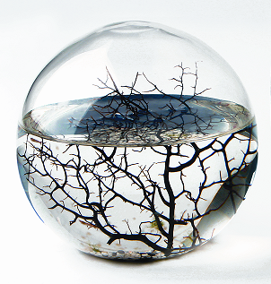
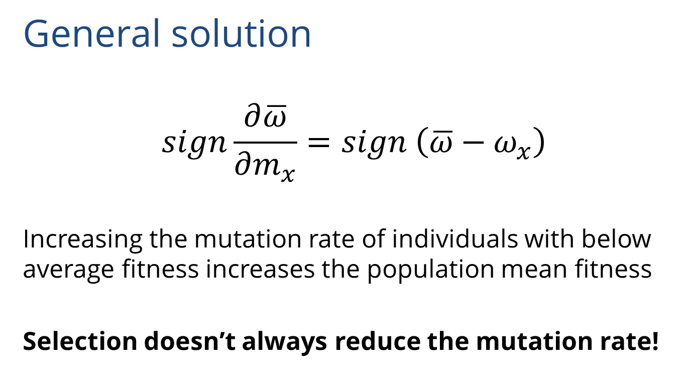
Constant environment
General solution
$$sign\frac{∂\overline{ω}}{∂m_{x}}=sign \left(\overline{ω}−ω_{x}\right)$$
Increasing the mutation rate of individuals with below average fitness increases the population mean fitness
Selection doesn’t always reduce the mutation rate!
Ram & Hadany, Evolution 2012

Slide 22

Constant environment
Constitutive mutator (CM)
Ram & Hadany, Evolution 2012

Slide 23

Constant environment
Stress-induced mutator (SIM)
No beneficial mutations
Ram & Hadany, Evolution 2012

Slide 24
Modified Mean Fitness Principle
Mutation, migration, individual learning…
Increasing generation of variation in below-average individuals increases the population mean fitness
Modifier allele favored by selection
Ram, Altenberg, Liberman, Feldman, TPB 2018
Notes:
איור של הגירה?

Slide 25

Changing environments
The Red Queen hypothesis:
van Valen, 1973
It takes all the running you can do, to keep in the same place.
- Lewis Carrol, Through the Looking Glass

Slide 26

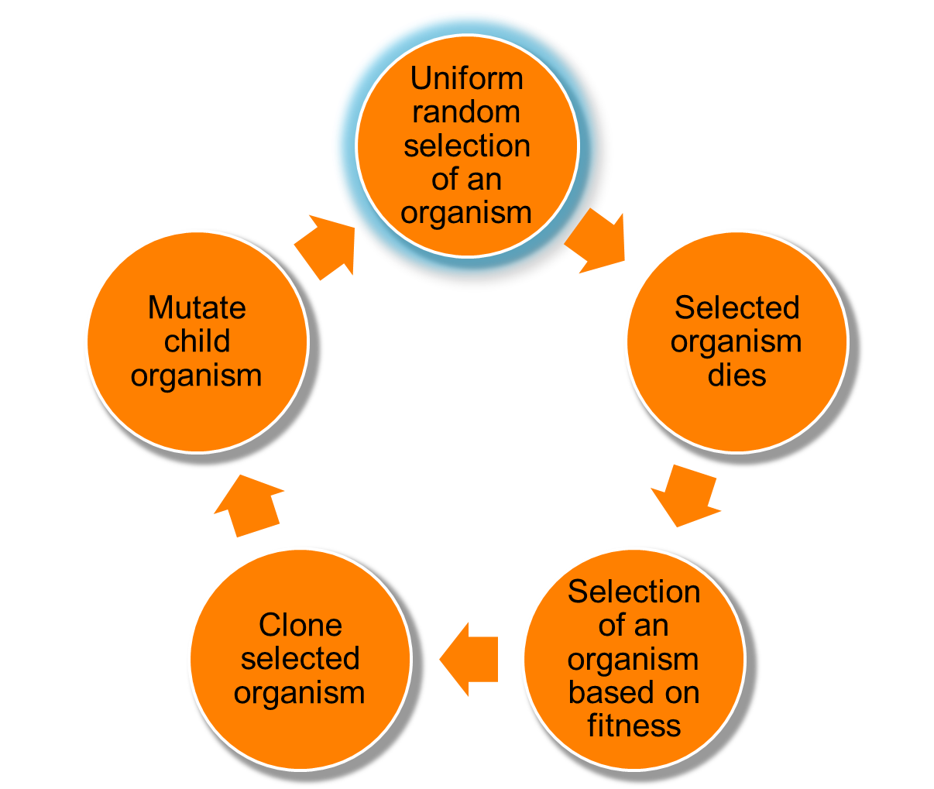
Changing environments
https://github.com/yoavram/proevolutionsimulation
Evolutionary simulations
100,000 asexual individuals
1,000 genes
Random environmental changes
Competitions between mutator alleles
100,000s simulations, run on dedicated cluster with 400-500 cores
https://github.com/yoavram/proevolutionsimulation
Ram & Hadany, Evolution 2012

Slide 27
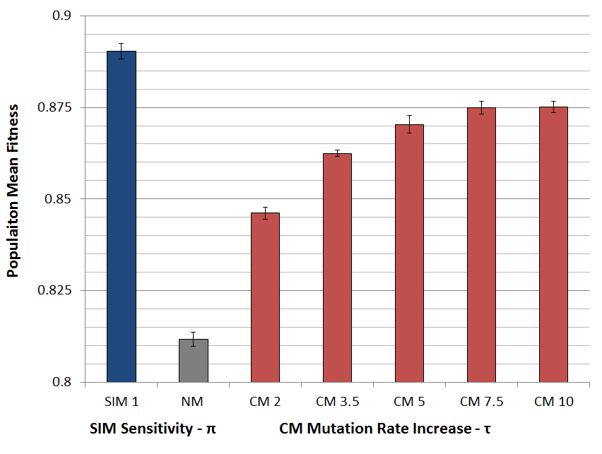
Populations with SIM are fitter
Ram & Hadany, Evolution 2012

Slide 28

SIM wins competitions
Ram & Hadany, Evolution 2012

Slide 29

SIM wins competitions
Ram & Hadany, Evolution 2012

Slide 30
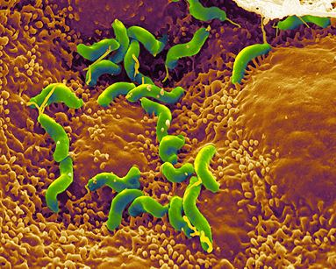
Summary: Evolution of stress-induced mutation
Stress-induced mutators evolve:
In finite & infinite populations
In constant & changing environments
2nd order selection can lead to the evolution of stress-induced mutagenesis in asexual populations
Selection for evolvability
H. pylori

Slide 31
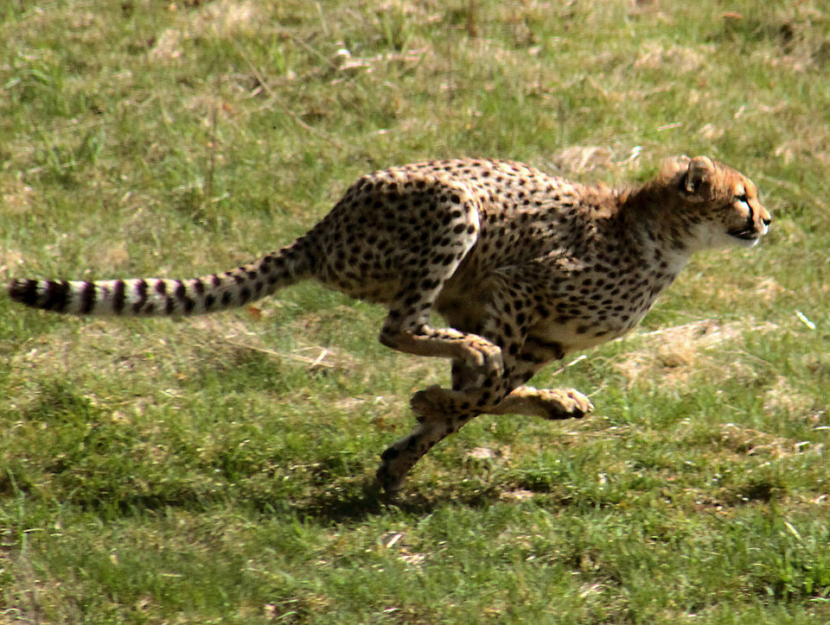
Consequences of Stress-Induced Mutagenesis
Can SIM make adaptation faster?
Malene Thyssen

Slide 32
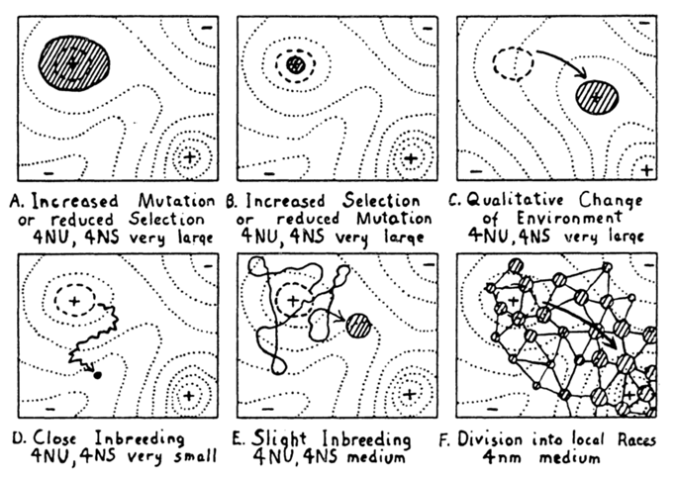
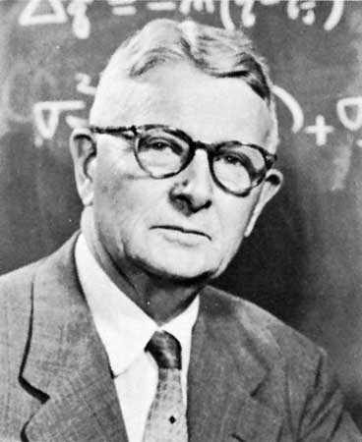
Adaptive peak shifts
Sewall Wright, 1931:
If a new adaptation requires several, separately deleterious mutations, how can it evolve?
Wright, Am. Nat. 1988

Slide 33
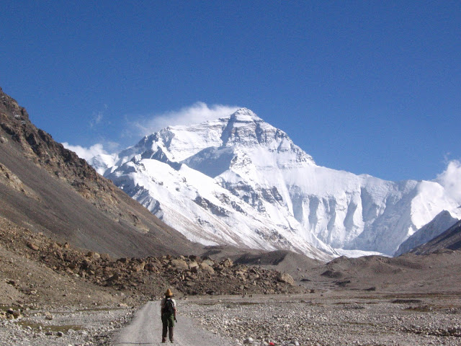
Simple landscape

Slide 34
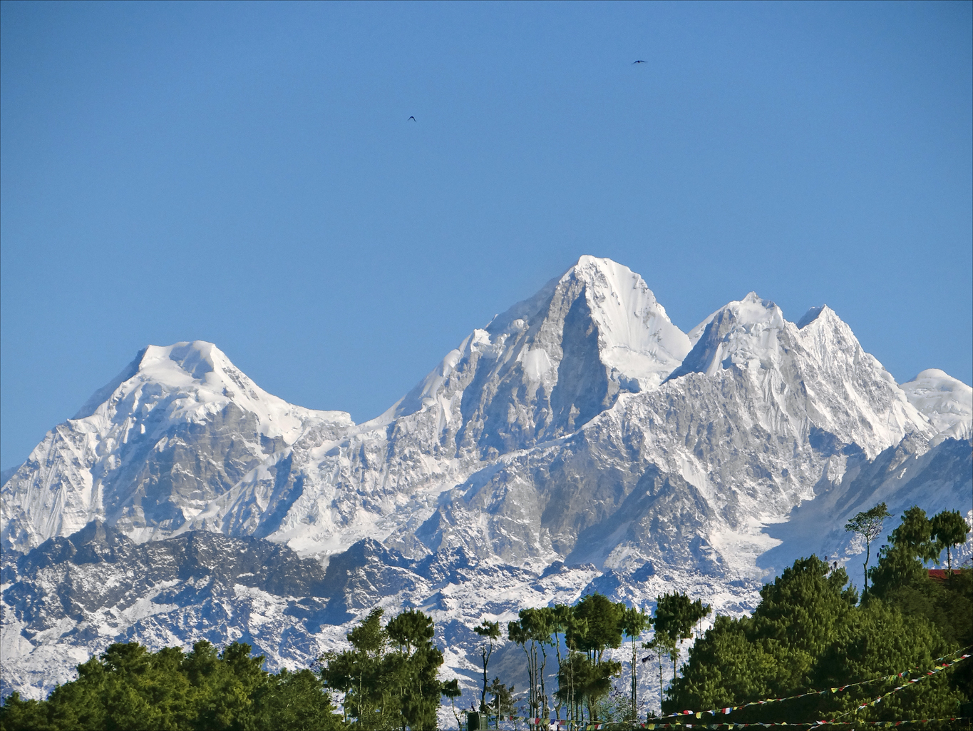
Rugged landscape

Slide 35
Adaptive peak shift

Slide 36
SIM & rugged landscapes
Increasing the mutation rate in individuals below both peaks
High mutation rate
Low mutation rate

Slide 37
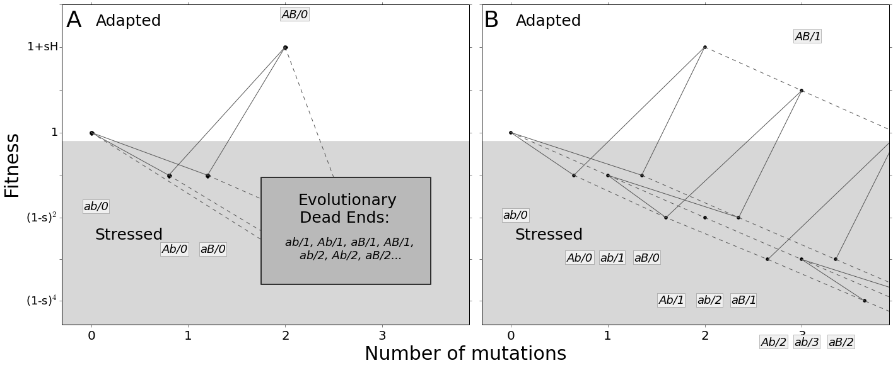
Deterministic model
Ram & Hadany, PRSB 2014

Slide 38
Estimating adaptation time
Adaptation has two stages:
Waiting for the double mutant
Fixation of the double mutant

Slide 39
Estimating adaptation rate
Adaptation has two stages:
Waiting for the double mutant
Fixation of the double mutant

Slide 40
Estimating adaptation rate
Adaptation has two stages:
Waiting for the double mutant
Fixation of the double mutant

Slide 41
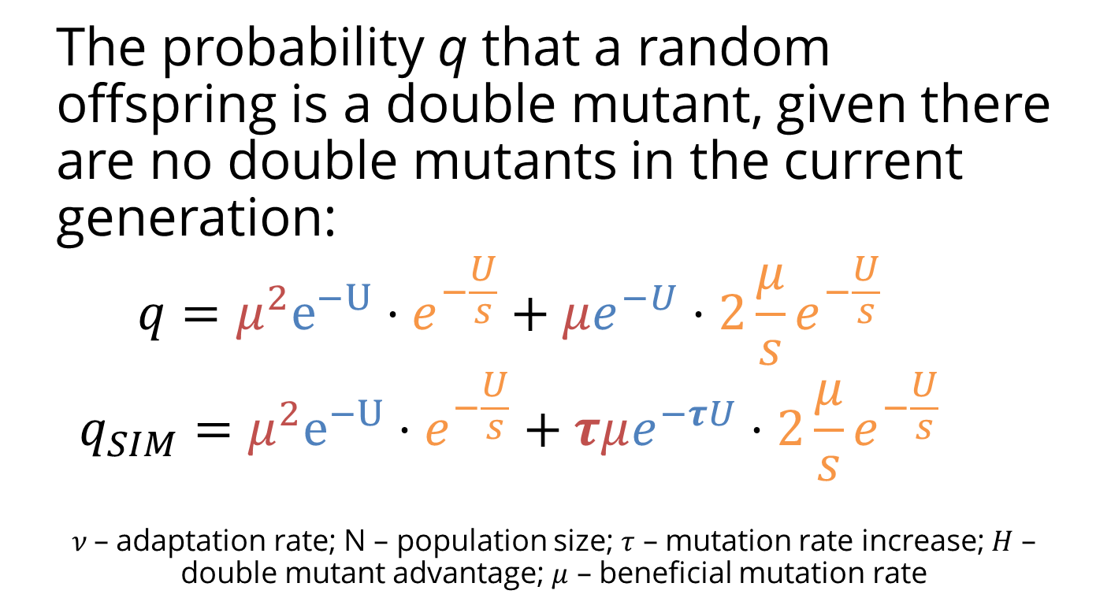
Deterministic model
The probability q that a random offspring is a double mutant, given there are no double mutants in the current generation:
$$q=μ^{2}e^{−U}⋅e^{−\frac{U}{s}}+μe^{−U}⋅2\frac{μ}{s}e^{−\frac{U}{s}}$$
$$q_{SIM}=μ^{2}e^{−U}⋅e^{−\frac{U}{s}}+τμe^{−τU}⋅2\frac{μ}{s}e^{−\frac{U}{s}}$$
$ν$– adaptation rate; N – population size; $τ$ – mutation rate increase; $H$ – double mutant advantage; $μ$ – beneficial mutation rate
Ram & Hadany, PRSB 2014

Slide 42
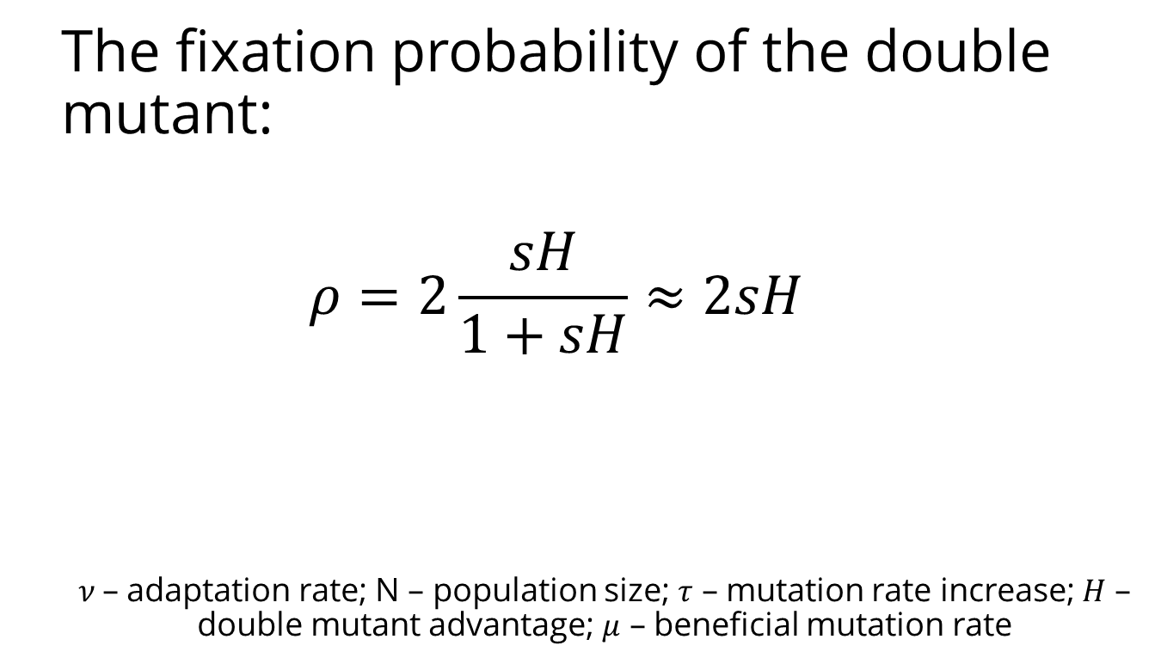
Deterministic model
The fixation probability of the double mutant:
$$ρ=2\frac{sH}{1+sH}≈2sH$$
$ν$– adaptation rate; N – population size; $τ$ – mutation rate increase; $H$ – double mutant advantage; $μ$ – beneficial mutation rate
Eshel 1981
Ram & Hadany, PRSB 2014

Slide 43
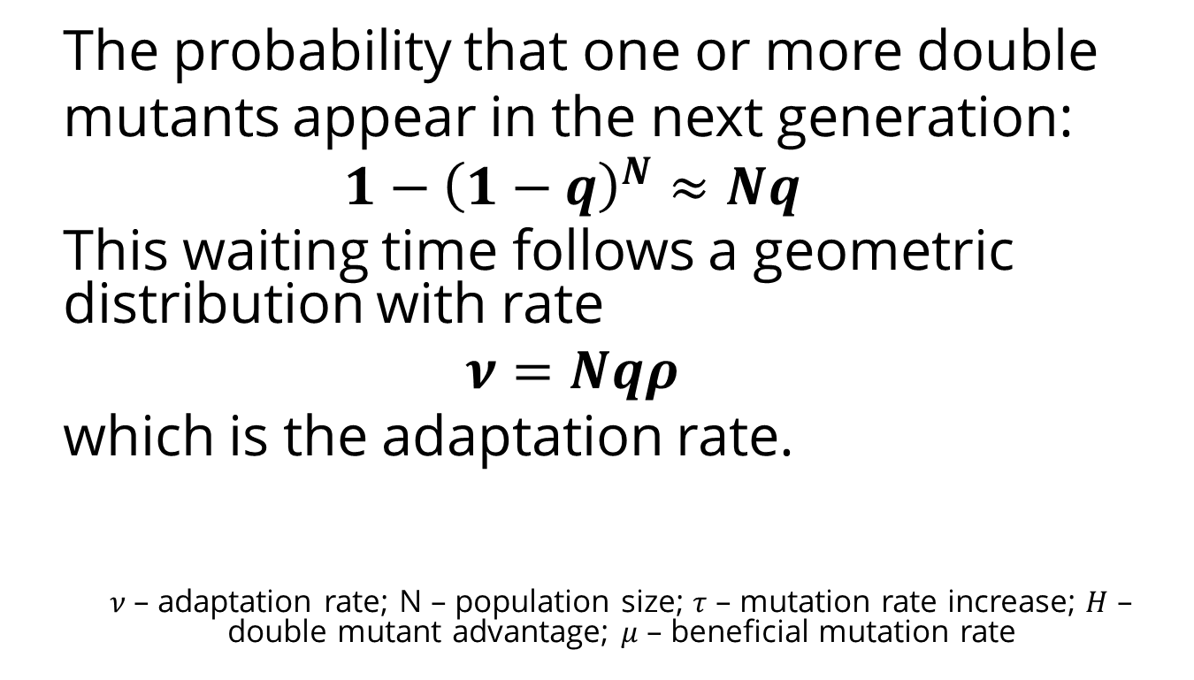
Deterministic model
The probability that one or more double
mutants appear in the next generation:
$$1−{\left(1−q\right)}^{N}≈Nq$$
This waiting time follows a geometric distribution with rate
$$ν=Nqρ$$
which is the adaptation rate.
$ν$– adaptation rate; N – population size; $τ$ – mutation rate increase; $H$ – double mutant advantage; $μ$ – beneficial mutation rate
Ram & Hadany, PRSB 2014

Slide 44
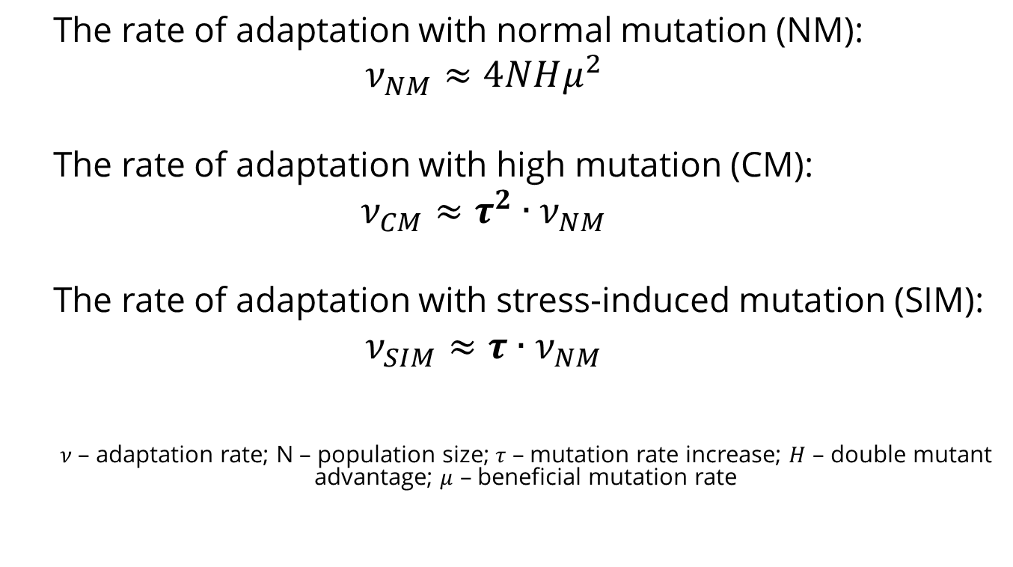
Deterministic results
The rate of adaptation with normal mutation (NM):
$$ν_{NM}≈4NHμ^{2}$$
The rate of adaptation with high mutation (CM):
$$ν_{CM}≈τ^{2}∙ν_{NM}$$
The rate of adaptation with stress-induced mutation (SIM):
$$ν_{SIM}≈τ∙ν_{NM}$$
$ν$– adaptation rate; N – population size; $τ$ – mutation rate increase; $H$ – double mutant advantage; $μ$ – beneficial mutation rate
Ram & Hadany, PRSB 2014

Slide 45
Stochastic model
https://github.com/yoavram/ruggedsim
No MSB assumption
No Dead Ends
Genetic drift
Ram & Hadany, PRSB 2014

Slide 46
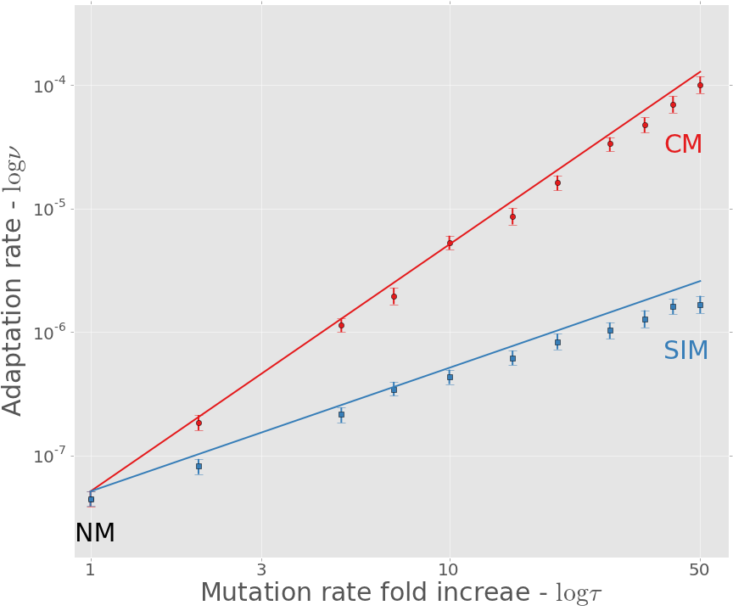
Adaptation rate
https://github.com/yoavram/ruggedsim
Approximation
Simulation
Ram & Hadany, PRSB 2014

Slide 47
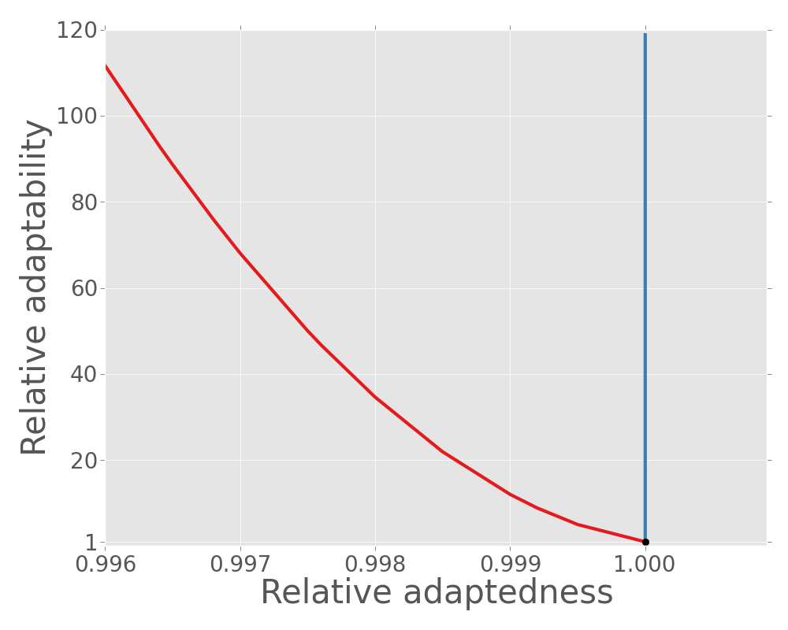
Stress-induced mutation increases adaptation rate without jeopardizing mean fitness
Relative Adaptation Rate
stress-induced mutation
constitutive mutation
Relative Mean Fitness
Ram & Hadany, Proceedings B, 2014

Slide 48
In the presence of rare recombination
Recombination can:
Separate mutator from beneficial mutations
Increase non-mutator adaptation rate
Save constitutive mutators from deleterious mutations

Slide 49
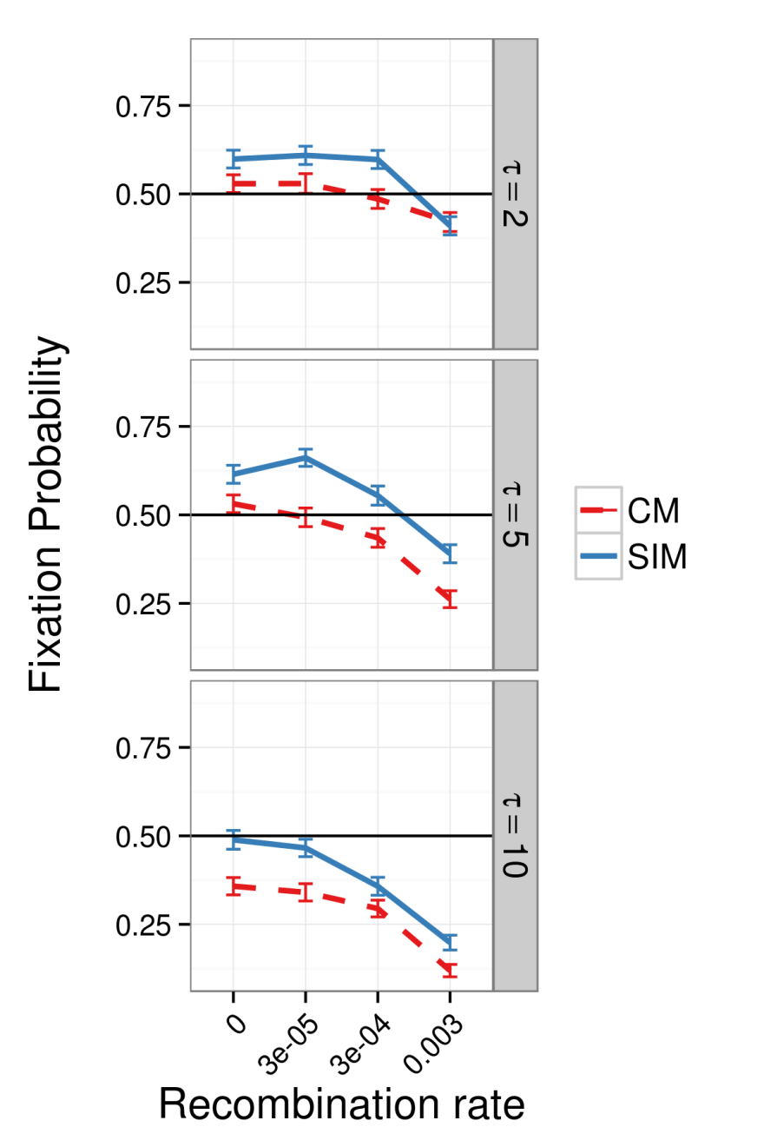
In the presence of HGT
Results suggest:
SIM > CM
SIM >= NM
When HGT is not much more frequent than mutation
Ram & Hadany, under review

Slide 50
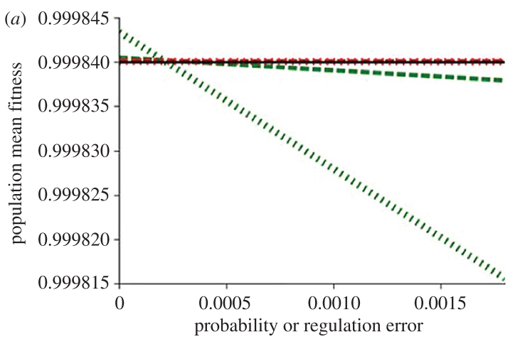
Stress-induced mutagenesis under uncertainty
Uncertainty
should you mutate?
SIM decreases mean fitness
Communication
Increase in mutation rate depends on population mean fitness
Robustness to uncertainty
Gur-Dellus, Ram & Hadany, Roy Soc Open Sci 2017

Slide 51
Evolution of stress-induced mutation
In constant environments
Ram & Hadany, Evolution 2012
Ram, Altenberg, Liberman, Feldman, TPB 2018
In complex & changing environments
Ram & Hadany, Evolution 2012
Ram & Hadany, Proceedings B 2014
In the presence of rare recombination
Ram & Hadany, under review
In the face of regulation errors
Dellus-Gur, Ram & Hadany, Royal Society Open Science 2017
Ongoing: experimental validation
Cooper lab, University of Houston

Slide 52
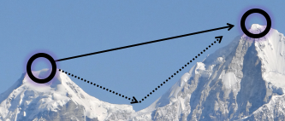
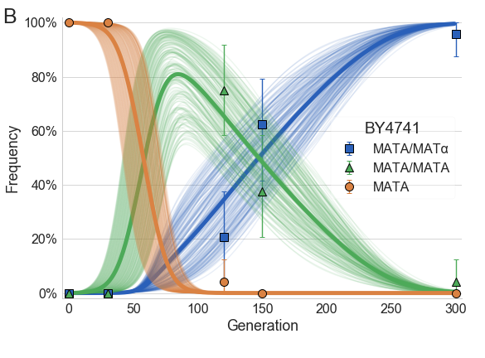



Computational Evolution Lab IDC Herzliya
Generation & transmission of variation
Microbial evolution & ecology
Cultural evolution
Now recruiting:
Students & research assistants
$$x−1$$
$$x$$
$$x+1$$
yoav@yoavram.com
@yoavram
www.yoavram.com

